Slide 1
Web Scraping Proposal Summary

Slide 2
Introduction
Project objectives include developing a custom web scraping tool for real estate listings on Immobiliare.it , ensuring data integration with Excel for efficiency.
Benefits of the project focus on data automation, streamlining the collection process, and enhancing overall efficiency in gathering real estate data.
Emphasize the user-friendly interface to provide a seamless experience in accessing and utilizing the scraped real estate data.

Slide 3
Current Data Collection Challenges
Manual extraction from Immobiliare.it is time-consuming, draining resources and impeding efficiency in data gathering.
Human errors are prevalent in manual data collection processes, leading to inaccuracies and potential data inconsistencies.
The inefficiencies of manual methods hinder the timely availability and utilization of crucial real estate data for analysis and decision-making.

Slide 4
Benefits of Automation
Increased Speed: Automation allows for rapid data collection, processing information at a much faster rate than manual methods.
Improved Accuracy: Custom web scraping tools reduce human error, leading to more precise and reliable data extraction.
Scalability and Cost Reduction: Automating data collection with a tailored tool enables seamless scalability and cuts down on operational expenses over time.

Slide 5
Scope of the Web Scraping Project
Develop a custom web scraping tool for extracting real estate listings from Immobiliare.it, tailored to efficiently gather and organize data for analysis.
Ensure seamless integration of the extracted data with Excel, enabling easy analysis, visualization, and reporting for stakeholders and decision-making processes.
Streamline the user experience by providing a user-friendly interface that simplifies the data collection and analysis process, increasing efficiency and accessibility.

Slide 6
Data Integration with Excel
The ability to manipulate and analyze data effectively within Excel enhances decision-making and reporting capabilities.
Excel offers practicality and convenience due to its widespread use, familiarity, and extensive functionalities for data processing tasks.

Slide 7
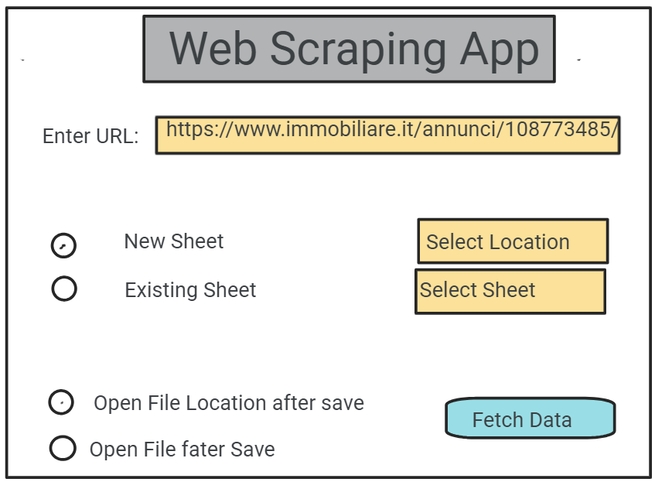
User-Friendly Interface
Designing an intuitive interface is crucial to navigate the web scraping tool effortlessly.
Clear navigation enhances user experience, making data collection from Immobiliare.it more accessible and efficient.
Prioritizing user-friendly features ensures that non-technical users can utilize the tool effectively for real estate data extraction.

Slide 8
Technical Implementation
Programming languages such as Python will be utilized for their versatility in web scraping tools and libraries like BeautifulSoup for parsing HTML content.
Adhering to legal regulations as given on https://www.immobiliare.it/robots.txt
Efficient data extraction capabilities and scalability for handling large volumes of web data.

Slide 9
Project Roadmap
Milestones | Timelines | Deliverables | Cost (USD)
Develop custom web scraping tool | 1 weeks | Functional web scraping tool | 350
Test tool functionality | 1 week | Integrated data in Excel sheets | 150
Integrate scraped data with Excel | 1 weeks | User manual and training materials | 150
Conduct user training sessions | 1 week | Process documentation for future maintenance | 50
USD 700

Slide 10
Conclusion and Call to Action
The web scraping project for Immobiliare.it will streamline real estate data collection, automate updates, and enhance data accuracy for improved decision-making.
With a custom web scraping tool and Excel integration, the project will save time and resources, leading to increased efficiency and productivity.
I urge you to approve this project for Immobiliare.it web scraping to propel our business forward

